Slide 1


Farm-Markets API
Presented by- Manish Sai Jakkula : ZPMJ-10114

Slide 2


Introduction
The Farm Markets API is a digital marketplace.
Built with Fast API and MongoDB.
Farmers can list products.
Buyers can purchase directly from farmers.
Uses JWT authentication for secure access.
PPT Farm-Markets

Slide 3

Tech Stack & Security Authentication
Fast API – High-performance web framework
MongoDB + Motor – Async database for users/products/orders
JWT – Authentication and session management
Passlib (bcrypt) – Password encryption
dotenv – Manage environment variables (like secret keys)
JWT tokens issued at login
Tokens blacklisted on logout
Role-based access control: Farmers manage products, Buyer's place orders
Passwords encrypted using bcrypt
PPT Farm-Markets

Slide 4



Key-
Endpoints
01
02
03
Users: Register, Login, Get Profile
Farmers: Create/Update farmer profile
Buyers: Create/Update buyer profile
Products: Add, Update, Delete (farmers only)
Orders: Place orders, Get orders (buyers only)
Logout: Blacklist the token
PPT Farm-Markets

Slide 5
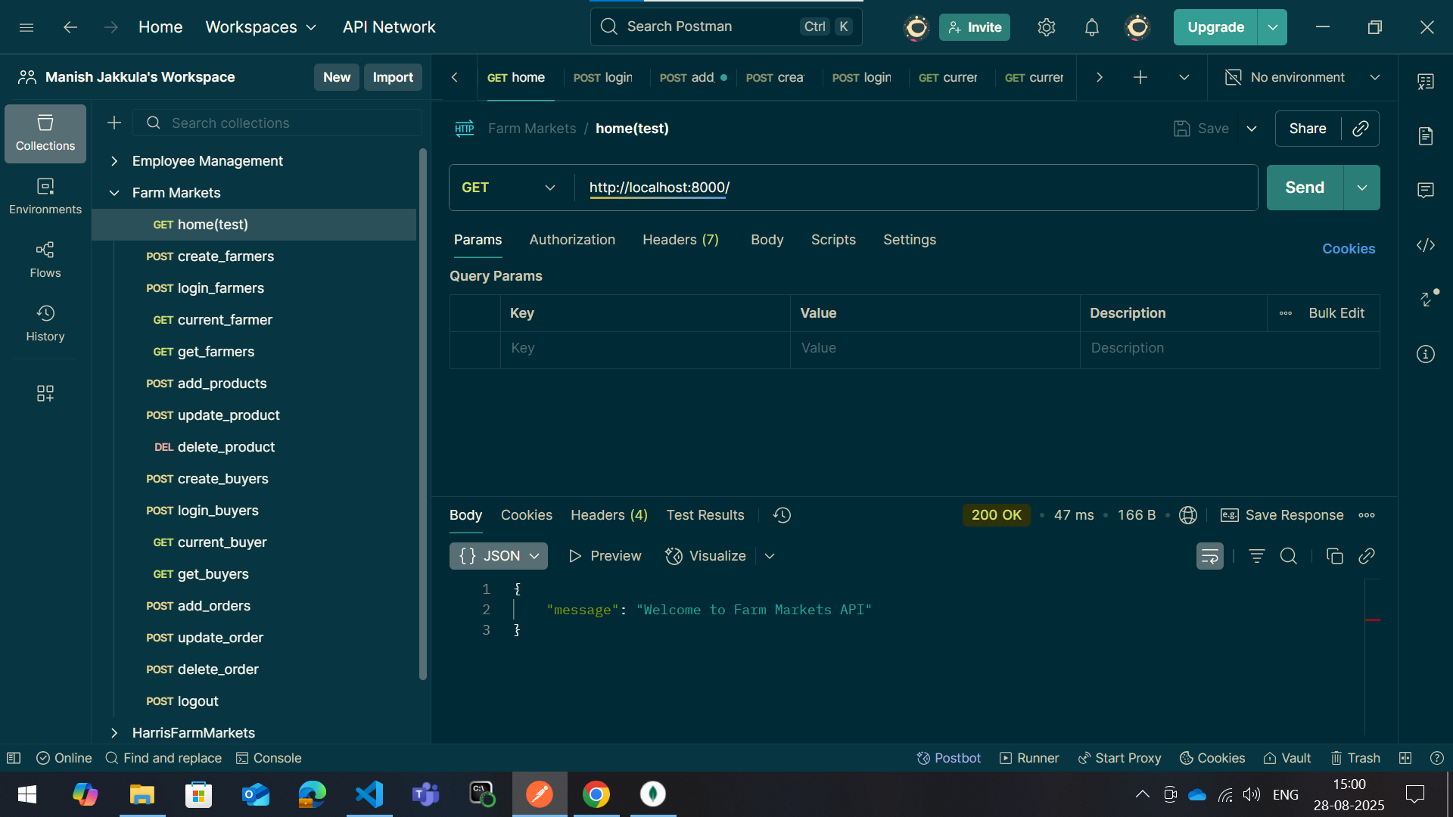
1. Home page

Slide 6
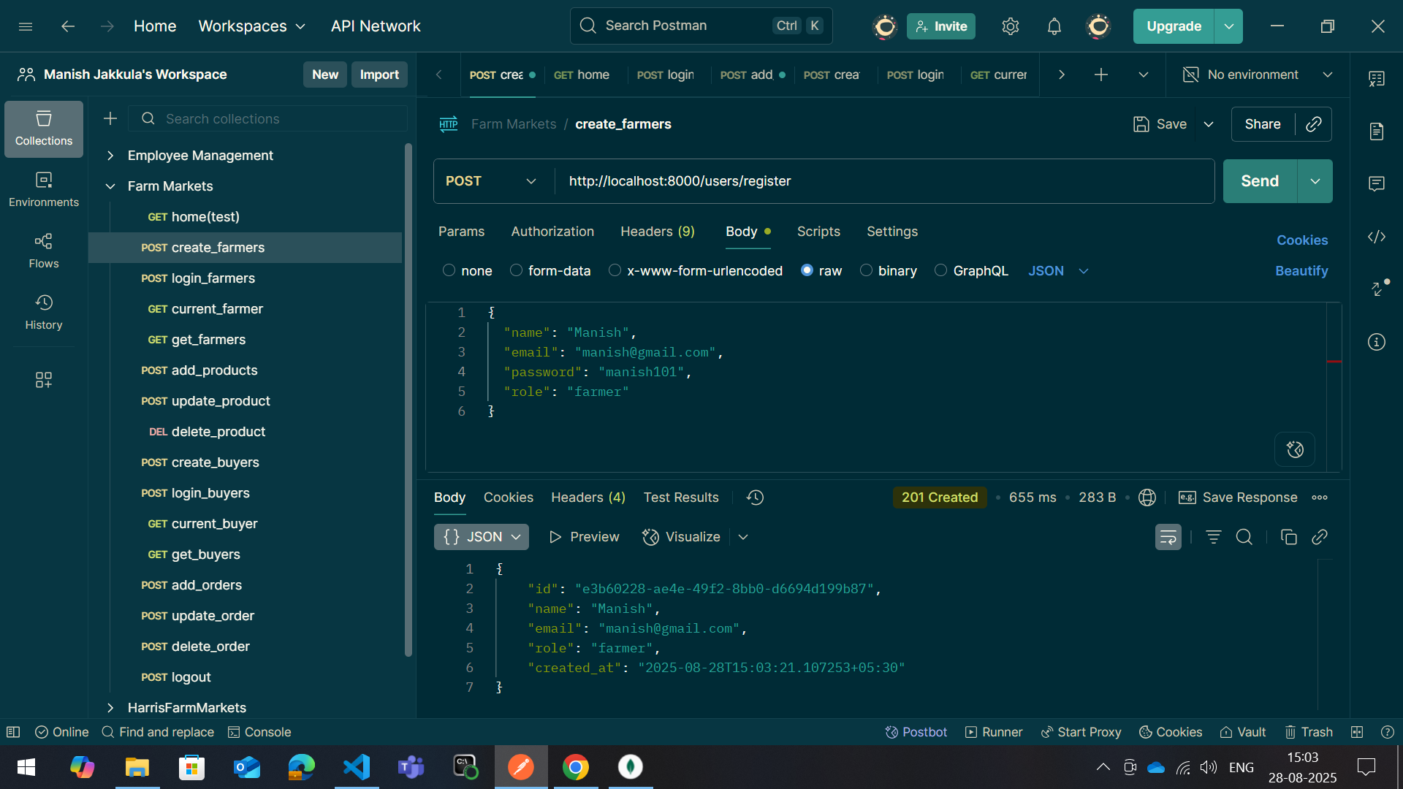
2. Create-farmer

Slide 7
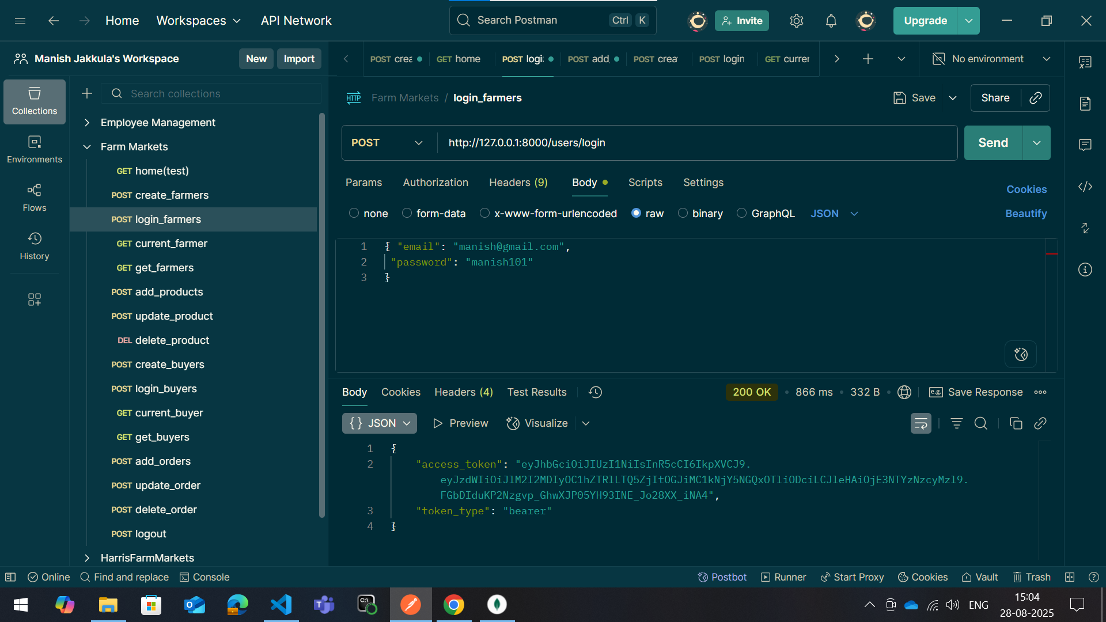
3. Login-farmer

Slide 8
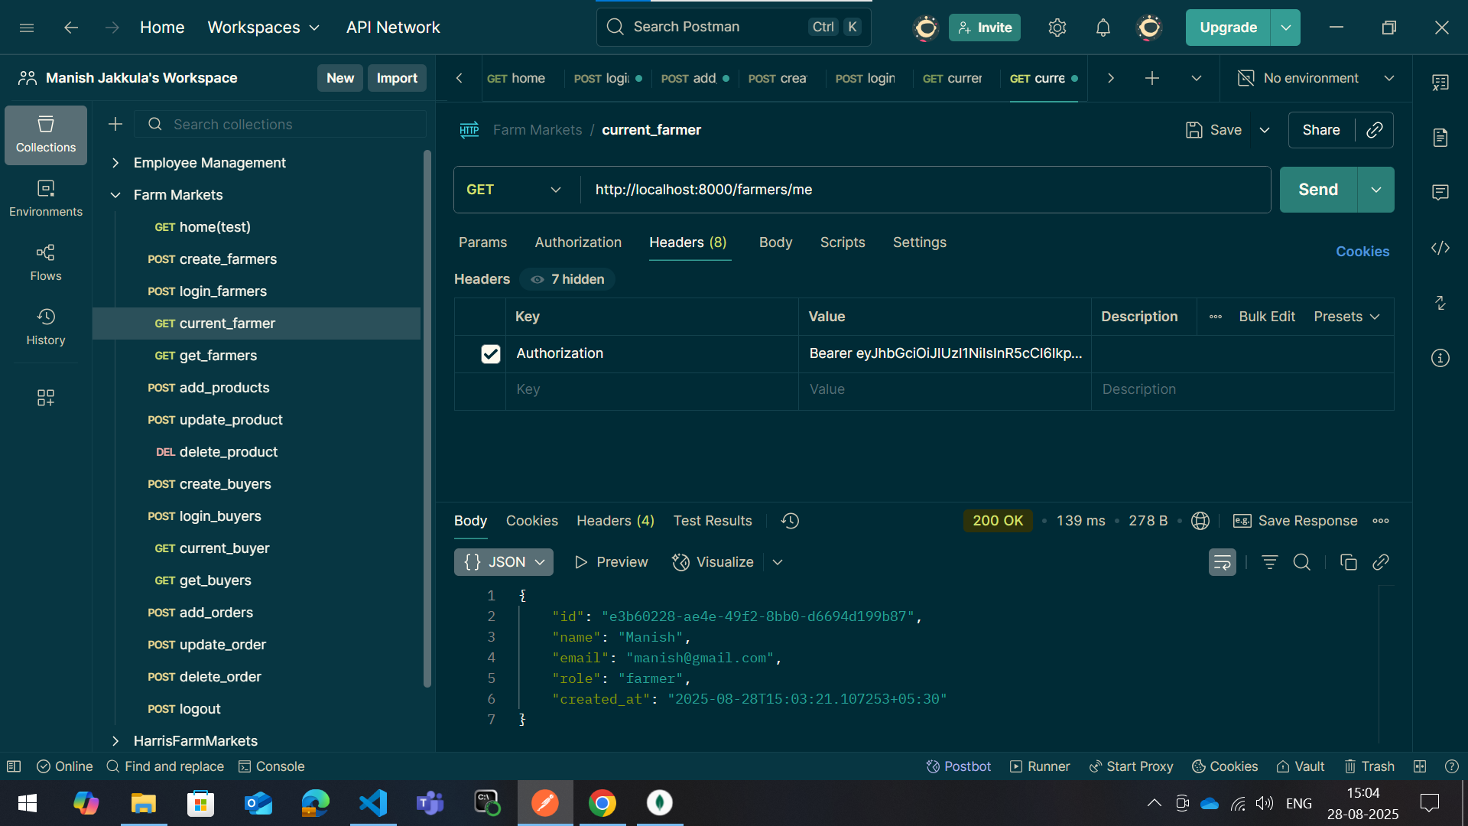
4. Current-farmer

Slide 9
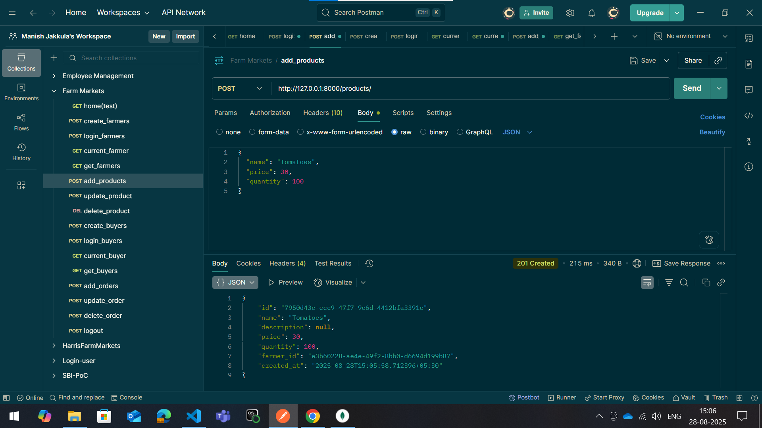
5. Add-product

Slide 10
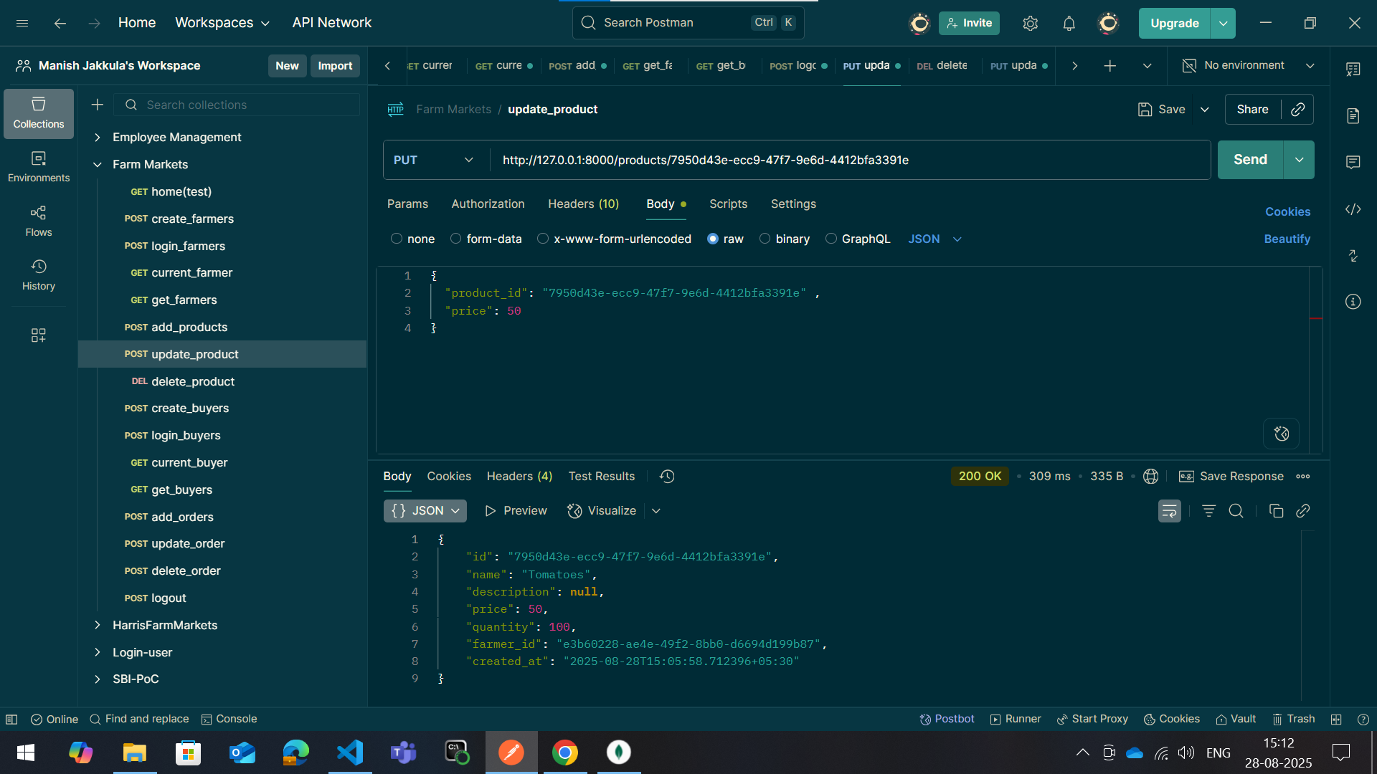
6. Update-product

Slide 11
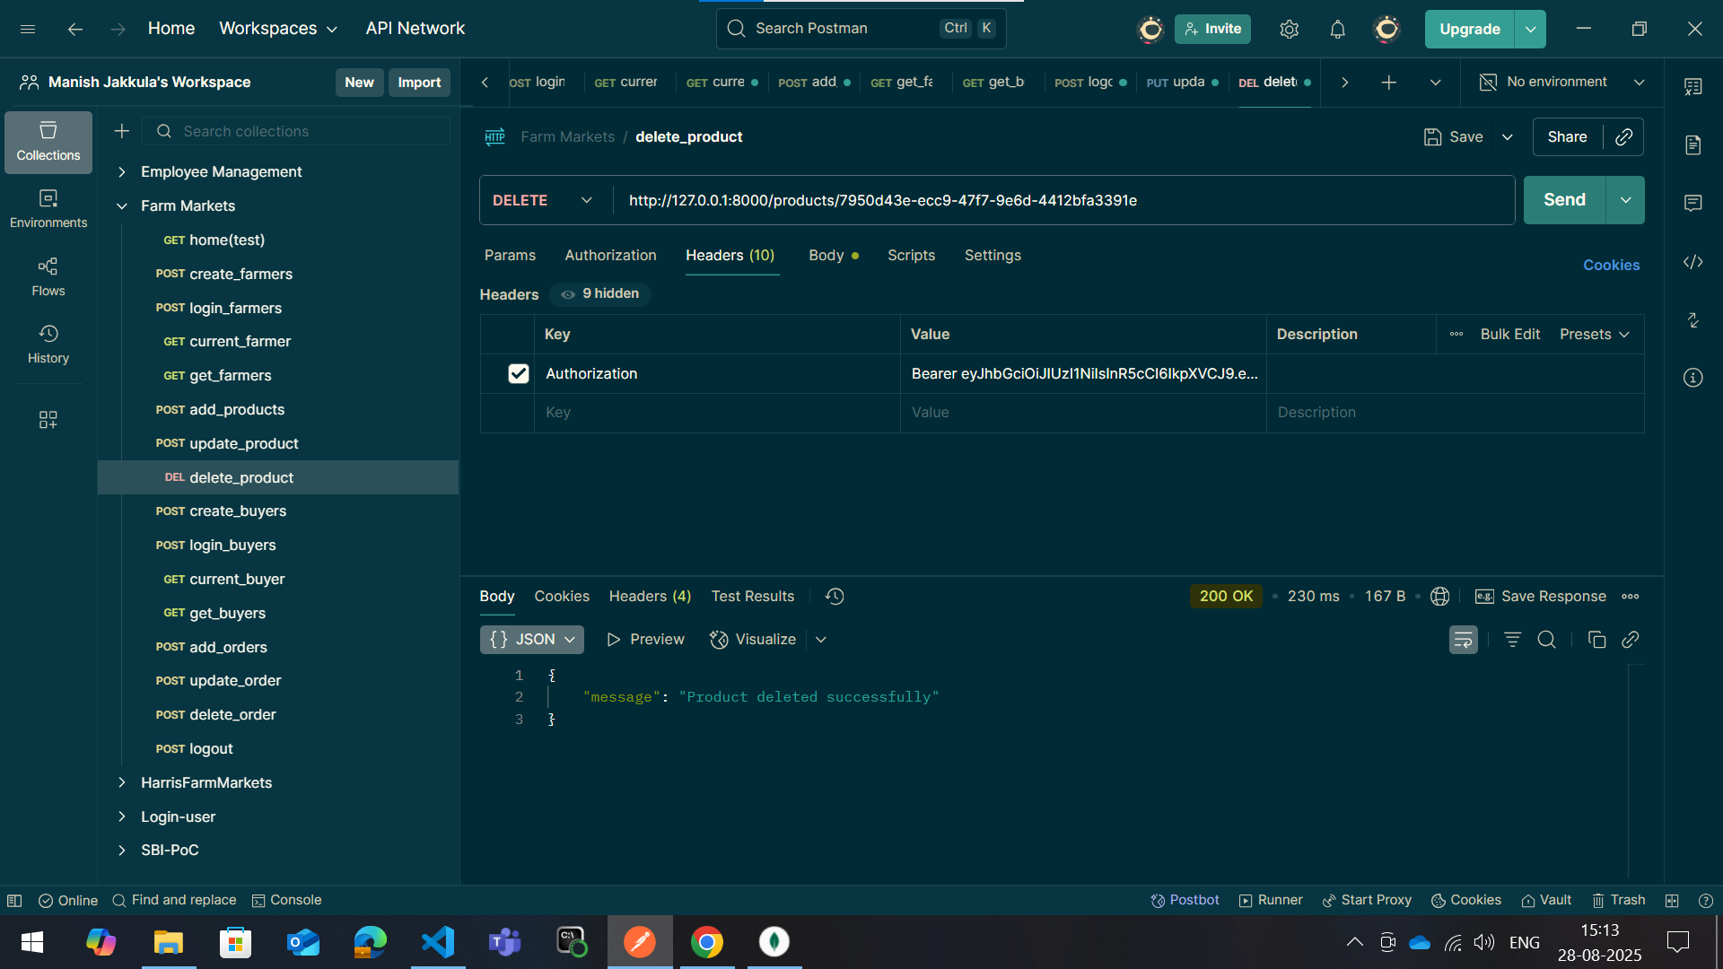
7. Delete-product

Slide 12
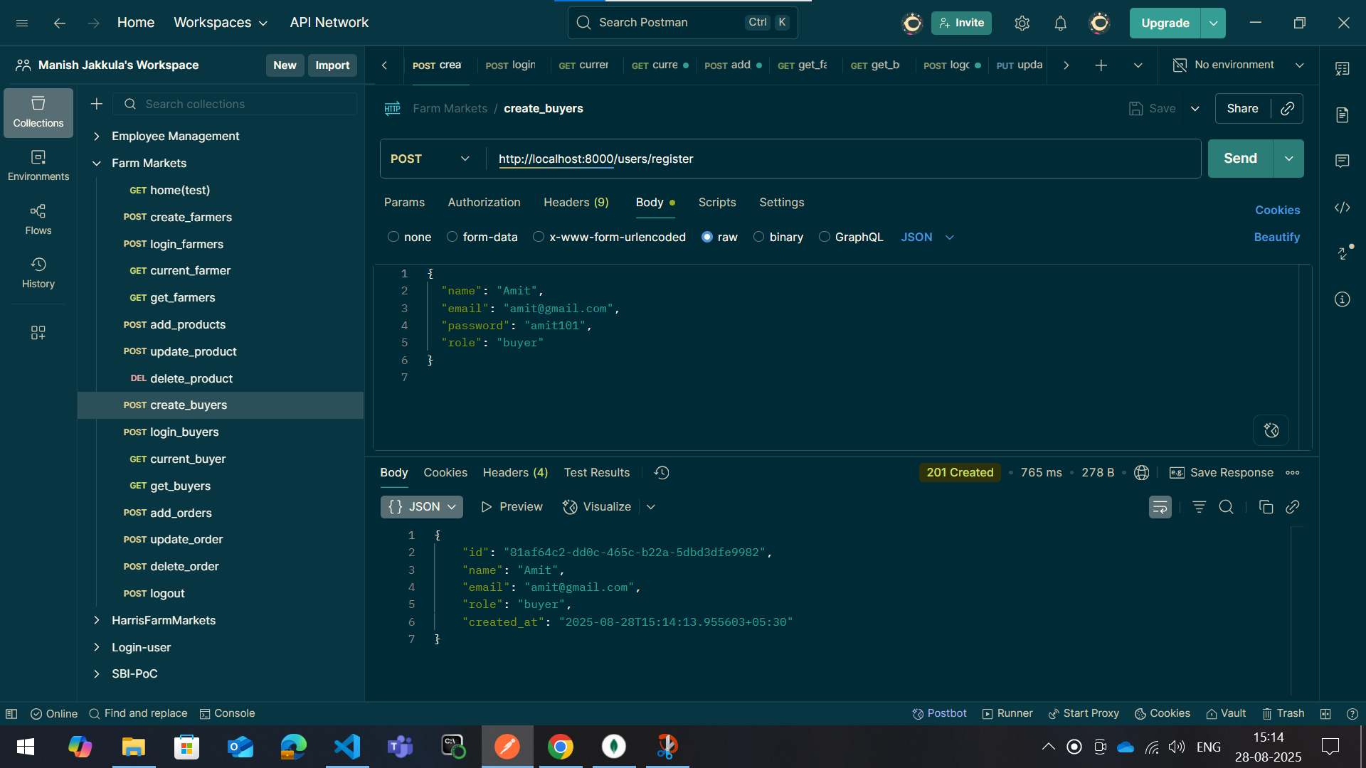
8. Create-buyer

Slide 13
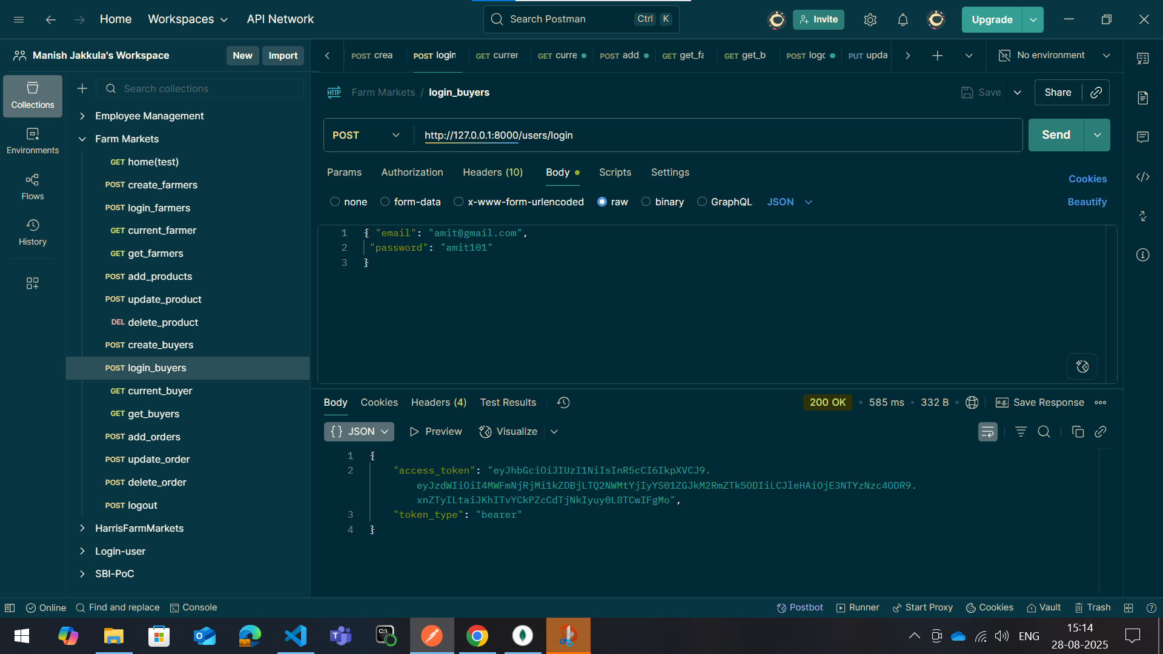
9. Login-buyer

Slide 14
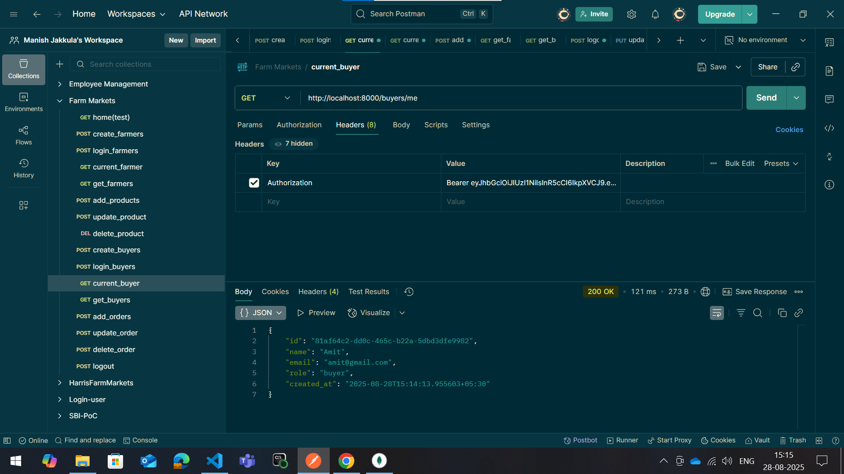
10. Current-buyer

Slide 15
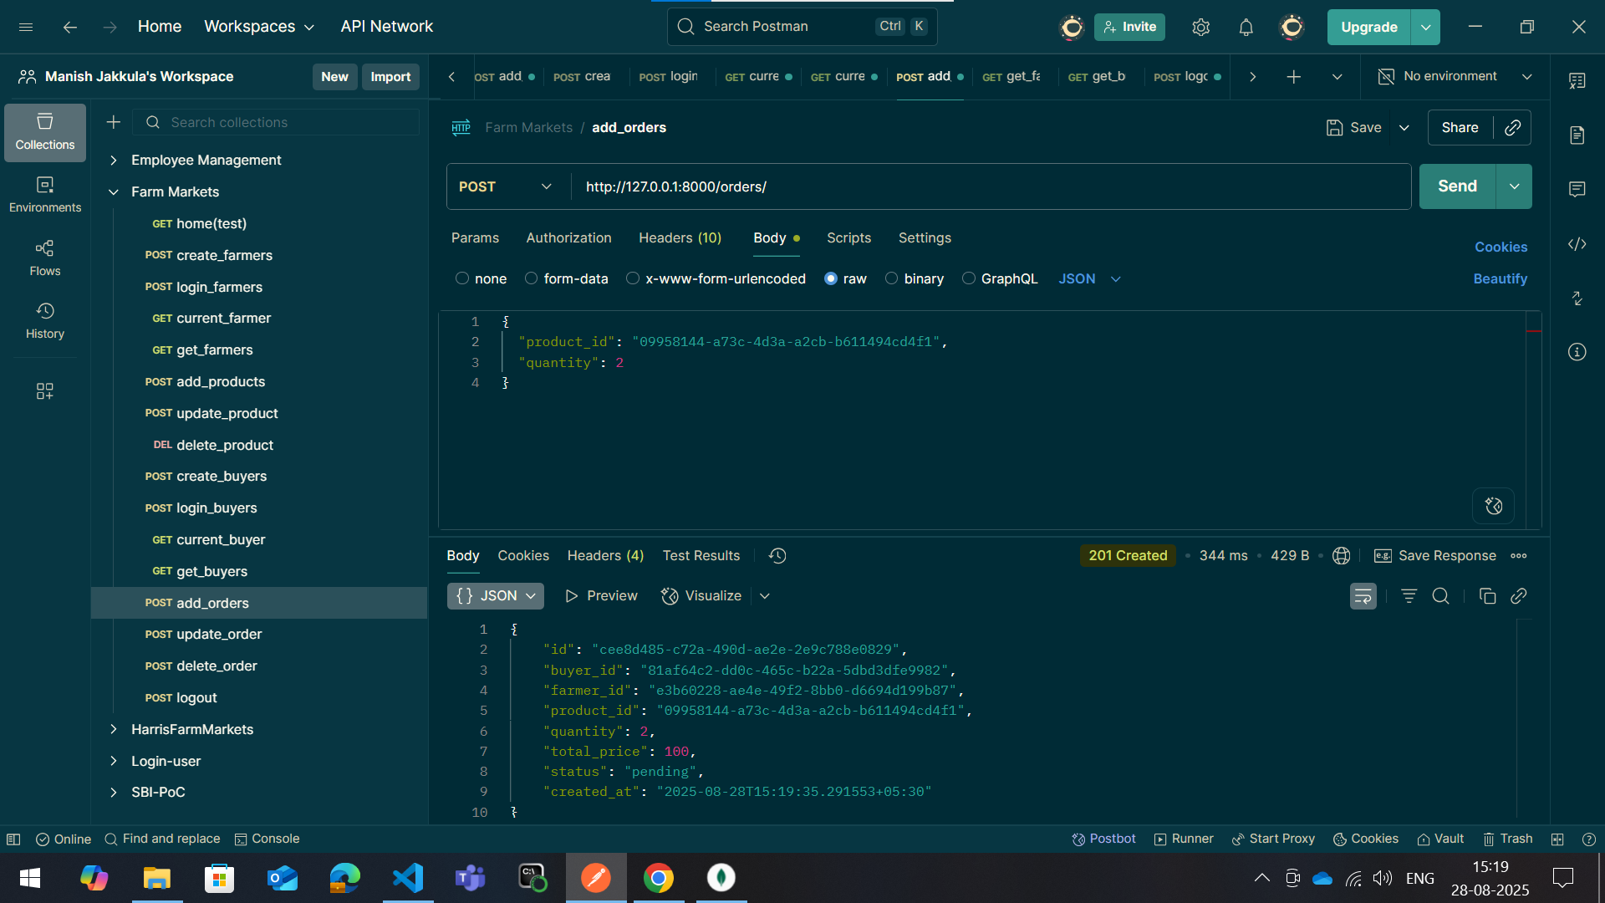
11. Add-order

Slide 16
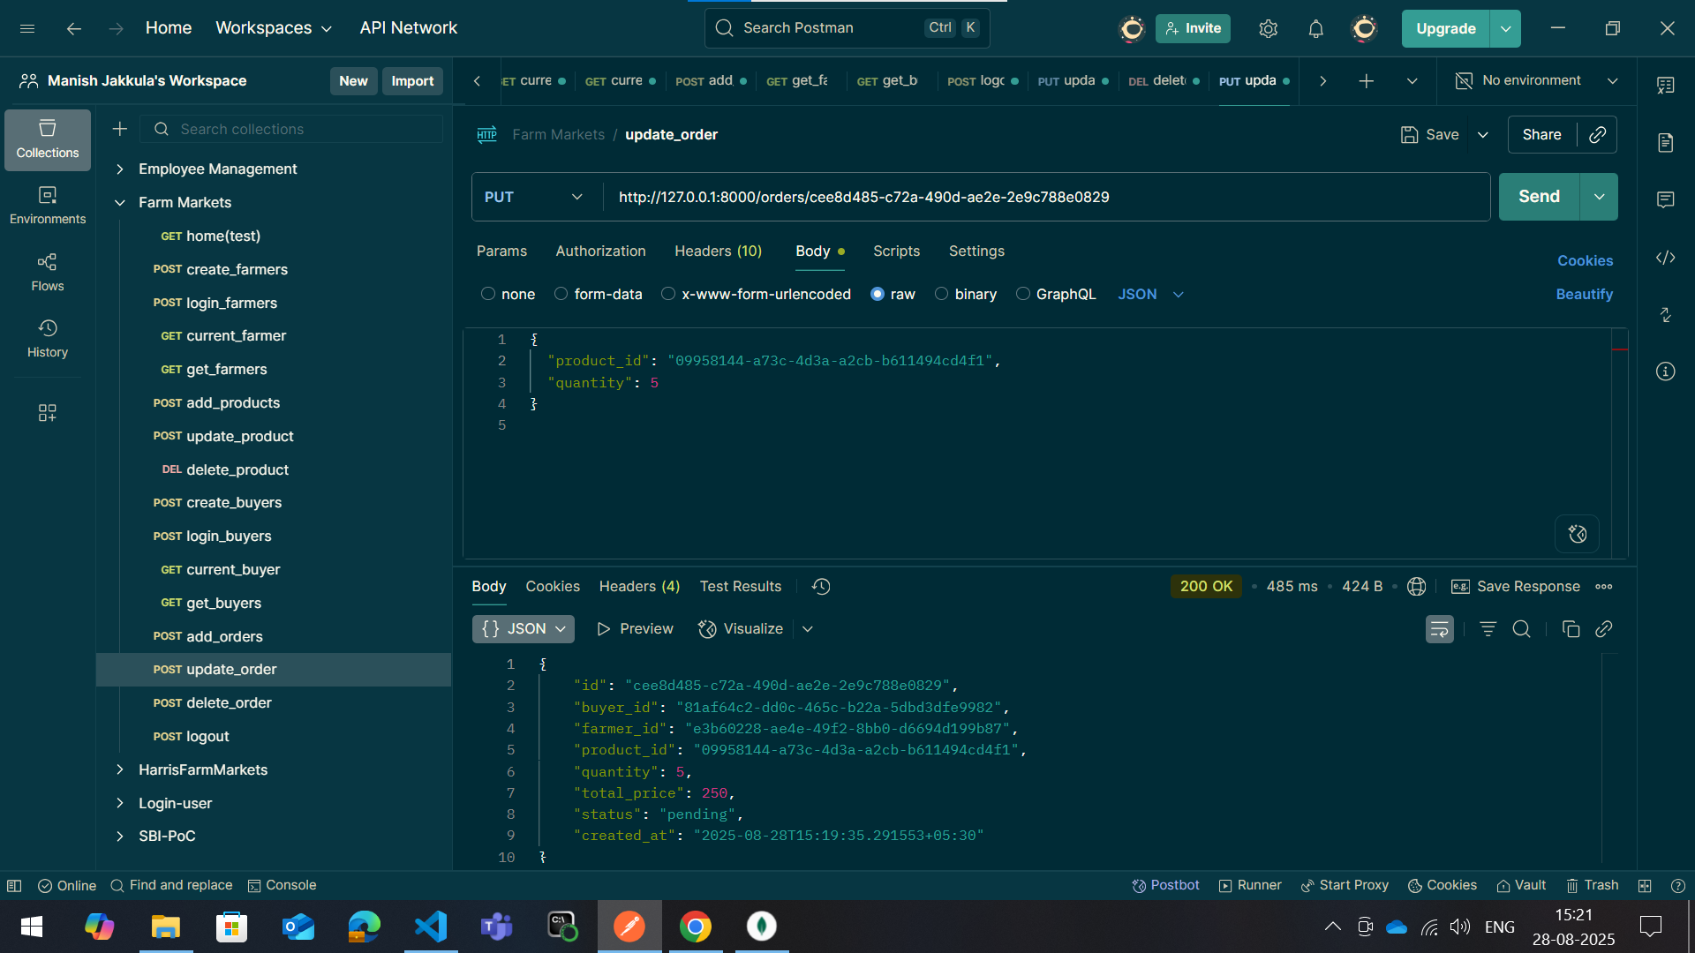
12. Update-order

Slide 17
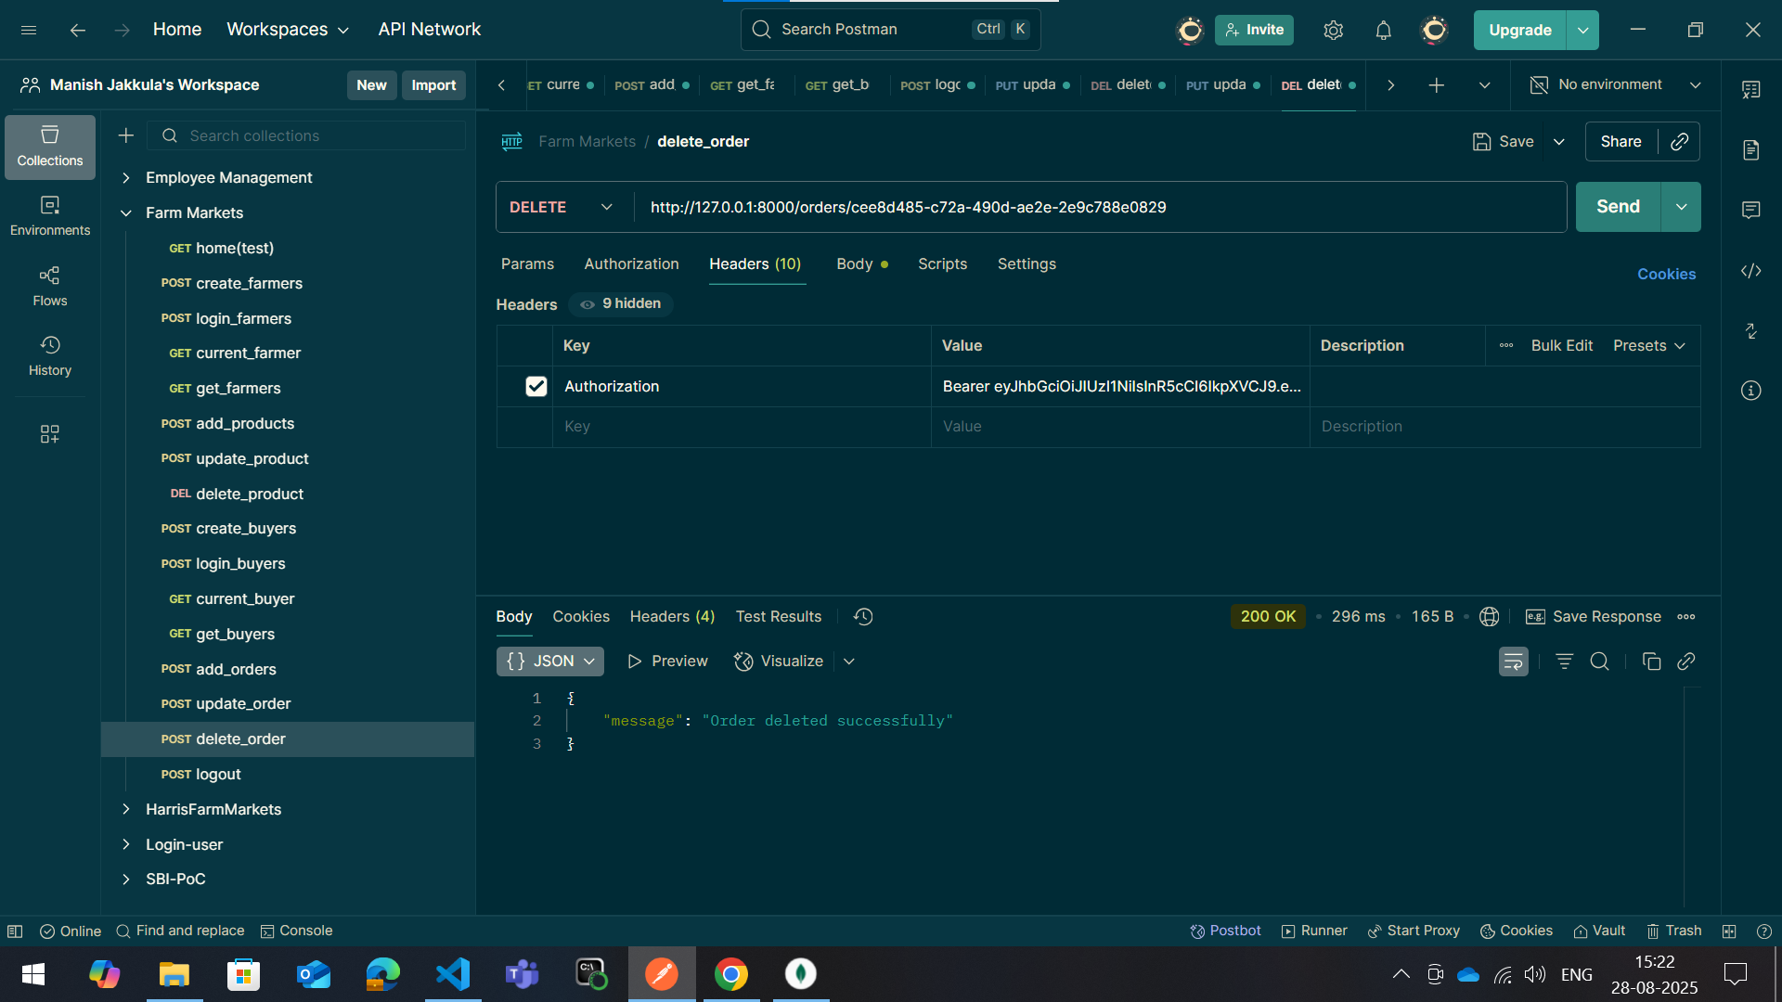
13. Delete-order

Slide 18
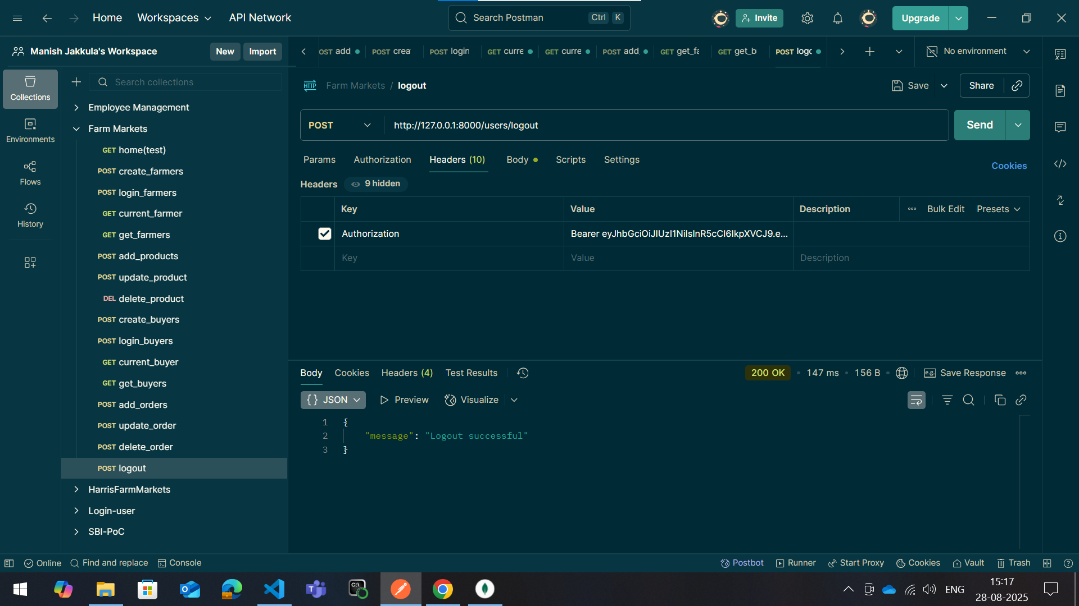
14. Logout-user

Slide 19
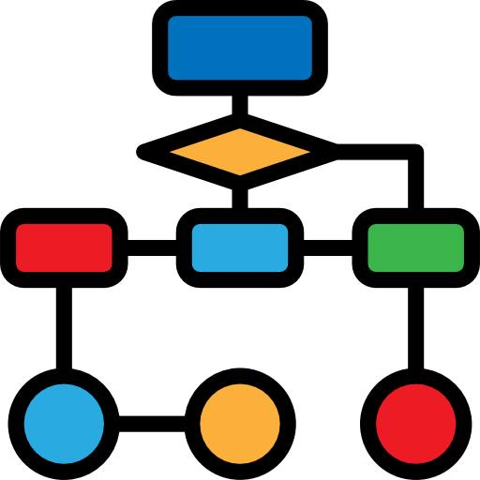

Usage flow
User registers and logs in → gets a JWT
Buyer browses available products
Buyer places an order, Orders can be tracked
Logout → token blacklisted
Conclusion
API creates a bridge between farmers and buyers
Ensures trust, transparency, and profitability
Helps farmers reach wider markets
Gives buyers fresh and affordable produce
Secure, scalable, and user-friendly solution
Benefits
For Farmers:
No middlemen → more profit
Builds trust with buyers
For Buyers:
Fresh produce directly from farmers
Transparent prices
Wide product choices
- Secure transactions
PPT Farm-Markets

Slide 20
Thank You

